Slide 1
WANDERLST-A PERSONALIZED TRAVEL PLANNING AND TRACKING APP
-K.SREE SAI SRAVANI
121322033007

Slide 2
DESCRIPTION
WanderLST is a comprehensive travel app designed to enhance every aspect of your journey, from planning to exploration and tracking. With personalized recommendations and easy-to-use tools, WanderLST transforms the travel experience by helping you create a unique itinerary tailored to your interests and preferences.
Key Features:
Custom Travel Itineraries: Build a personalized itinerary by selecting from curated recommendations based on your destination, budget, and interests. Whether you’re into adventure, culture, cuisine, or relaxation, WanderLST offers options that match your style.
Smart Suggestions: Receive recommendations for destinations, attractions, and activities suited to your preferences. WanderLST uses your past travel data and stated interests to suggest experiences you’ll love, making each trip unique and meaningful.
Budget and Expense Tracking: Track expenses to stay within budget, with options to categorize spending and set limits. WanderLST keeps your travel budget organized, offering a clear view of your financials while on the go.
Interactive Maps and Route Planning: View and organize destinations with interactive maps. WanderLST helps optimize your routes so you can make the most of your time, even on a tight schedule.
Trip Tracking and Memories: Document your trip through notes, photos, and check-ins, creating a digital journal you can revisit anytime. Share your memories and recommendations with friends or other WanderLST users.

Slide 3
PROGRAM
<?xml version="1.0" encoding="utf-8"?> <manifest xmlns:android="http://schemas.android.com/apk/res/android" xmlns:tools="http://schemas.android.com/tools"> <application android:allowBackup="true" android:dataExtractionRules="@xml/data_extraction_rules" android:fullBackupContent="@xml/backup_rules" android:icon="@mipmap/ic_launcher" android:label="@string/app_name" android:supportsRtl="true" android:theme="@style/Theme.TravelApp" tools:targetApi="31"> <activity android:name=".RegisterActivity" android:exported="false" android:label="RegisterActivity" android:theme="@style/Theme.TravelApp" /> <activity android:name=".SingaporeActivity"

Slide 4
android:exported="false" android:label="@string/title_activity_singapore" android:theme="@style/Theme.TravelApp" /> <activity android:name=".ParisActivity" android:exported="false" android:label="@string/title_activity_paris" android:theme="@style/Theme.TravelApp" /> <activity android:name=".BaliActivity" android:exported="false" android:label="@string/title_activity_bali" android:theme="@style/Theme.TravelApp" /> <activity android:name=".MainActivity" android:exported="true" android:label="@string/app_name"

Slide 5
android:theme="@style/Theme.TravelApp"/> <activity android:name=".LoginActivity" android:exported="true" android:label="@string/app_name" android:theme="@style/Theme.TravelApp"> <intent-filter> <action android:name="android.intent.action.MAIN" /> <category android:name="android.intent.category.LAUNCHER" /> </intent-filter> </activity> </application> </manifest>

Slide 6
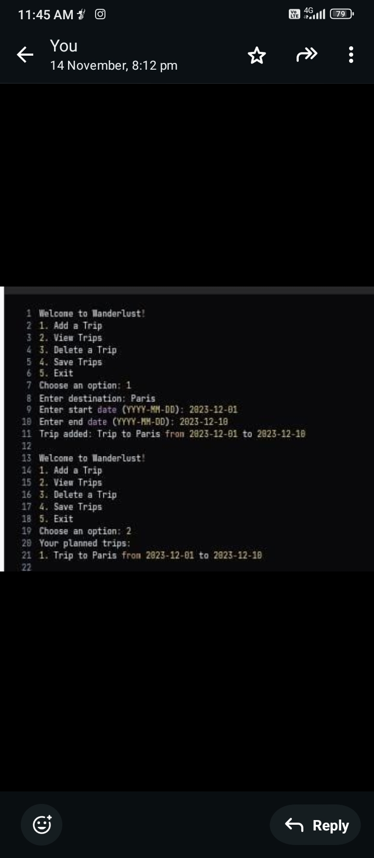
OUTPUT

Slide 7
o

Slide 20
OUTPUT:

